Slide 1
Chapter 6
Circular Motion and
Other Applications of Newton’s Laws

Slide 2
Circular Motion
Two analysis models using Newton’s Laws of Motion have been developed.
The models have been applied to linear motion.
Newton’s Laws can be applied to other situations:
  Objects traveling in circular paths
  Motion observed from an accelerating frame of reference
  Motion of an object through a viscous medium
Many examples will be used to illustrate the application of Newton’s Laws to a variety of new circumstances.
Introduction

Slide 3
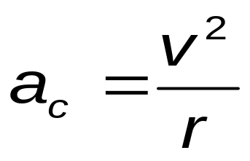

Uniform Circular Motion, Acceleration
A particle moves with a constant speed in a circular path of radius r with an acceleration.
The magnitude of the acceleration is given by
The centripetal acceleration, , is directed toward the center of the circle.
The centripetal acceleration is always perpendicular to the velocity.
If there were a component of acceleration parallel to v, the particle’s speed would be changing.
Section 6.1

Slide 4
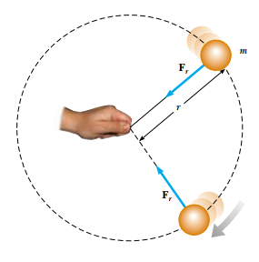

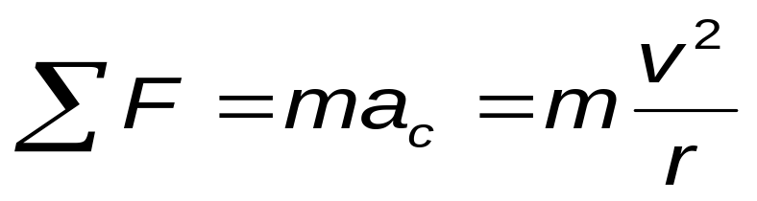
Uniform Circular Motion, Force
A force, , is associated with the centripetal acceleration.
The force is also directed toward the center of the circle.
Applying Newton’s Second Law along the radial direction gives
Section 6.1

Slide 5
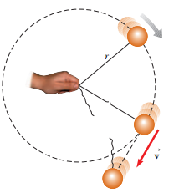
Uniform Circular Motion, cont.
A force causing a centripetal acceleration acts toward the center of the circle.
It causes a change in the direction of the velocity vector.
If the force vanishes, the object would move in a straight-line path tangent to the circle.
Section 6.1

Slide 6
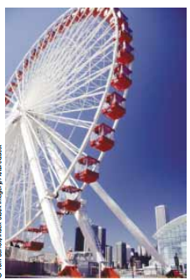
Quick Quiz 6.1
________________________________________________________
You are riding on a Ferris wheel that is rotating with constant speed. The car in which you are riding always maintains its correct upward orientation; it does not invert. (i)What is the direction of the normal force on you from the seat when you are at the top of the wheel? (a) upward (b) downward (c) impossible to determine (ii) From the same choices, what is the direction of the net force on you when you are at the top of the wheel?
________________________________________________________

Slide 7
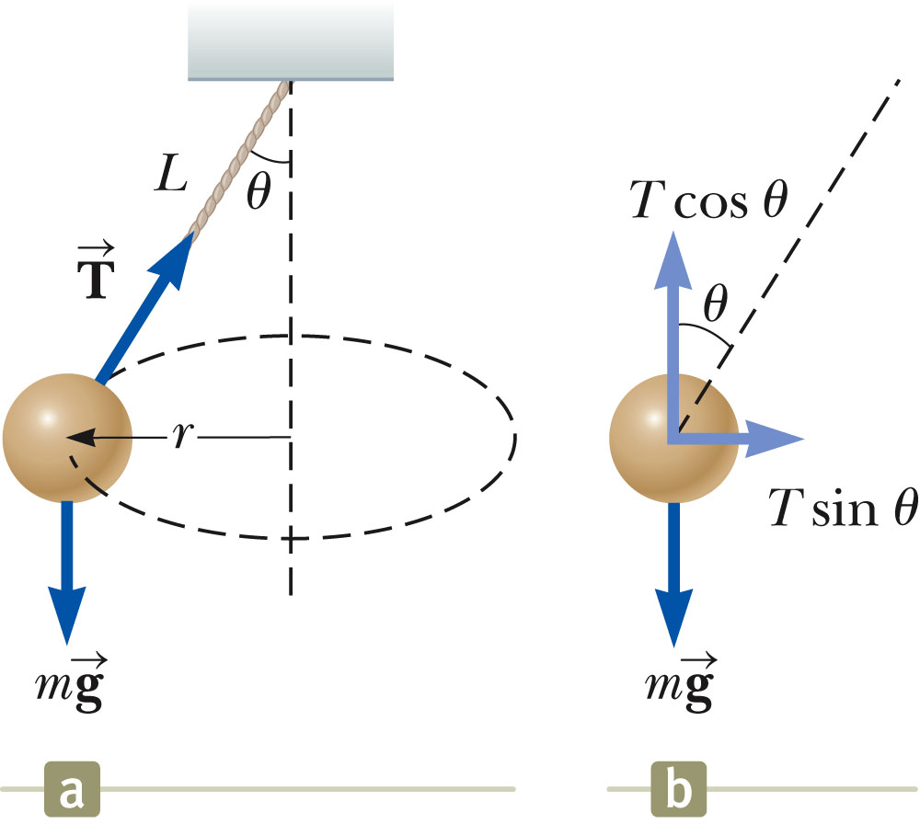
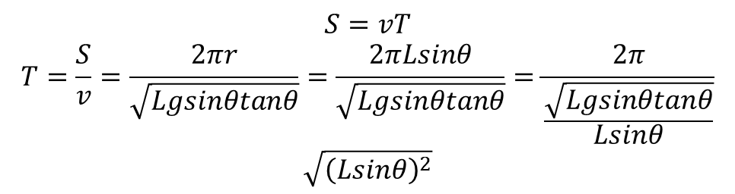
Problem 1 Conical Pendulum
A small object of mass m is suspended from a string of length L. The object revolves with constant speed v in a horizontal circle of radius r, as shown in Figure .
Because the string sweeps out the surface of a cone, the system is known as a conical pendulum. Find an expression for v.
Section 6.1

Slide 8
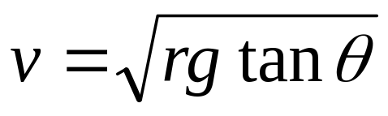
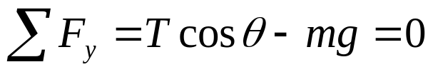
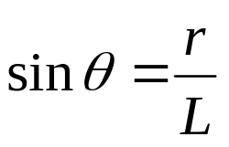


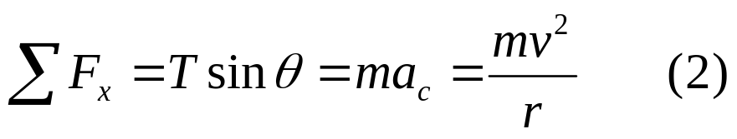
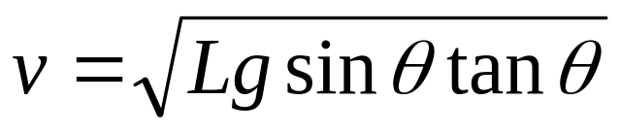
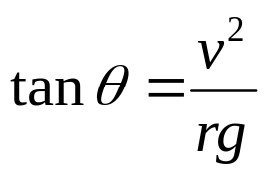
Solution:
Apply the particle in equilibrium model in the vertical direction:
Divide Equation (2) by Equation (1)
Incorporating

Slide 9
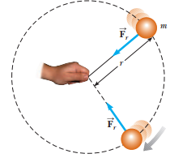
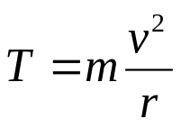
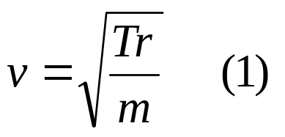
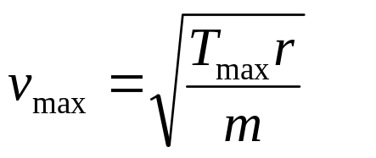
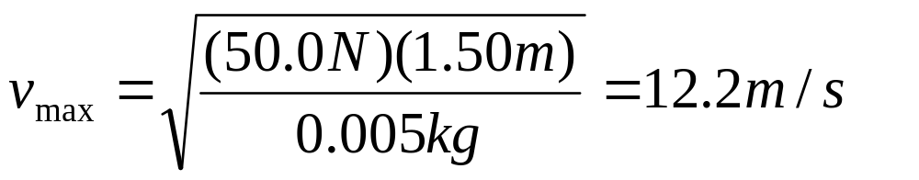
Problem 6.2:
  A ball of mass 0.500 kg is attached to the end of a cord 1.50 m long. The ball is whirled in a horizontal circle as shown in Figure 6.1. If the cord can withstand a maximum tension of 50.0 N, what is the maximum speed at which the ball can be whirled before the cord breaks? Assume the string remains horizontal during the motion.
  Solution: Applying Newton’s second law
  For maximum speed
Fig:6.1

Slide 10
Problem
A ball of mass 0.500 kg is attached to the end of a cord 1.50 m long. The ball is whirled in a horizontal circle as shown in Figure. If the cord can withstand a maximum tension of 50.0 N, what is the maximum speed at which the ball can be whirled before the cord breaks? Assume that the string remains horizontal during the motion.
What If? Suppose that the ball is whirled in a circle of larger radius at the same speed v. Is the cord more likely to break or less likely?

Slide 11
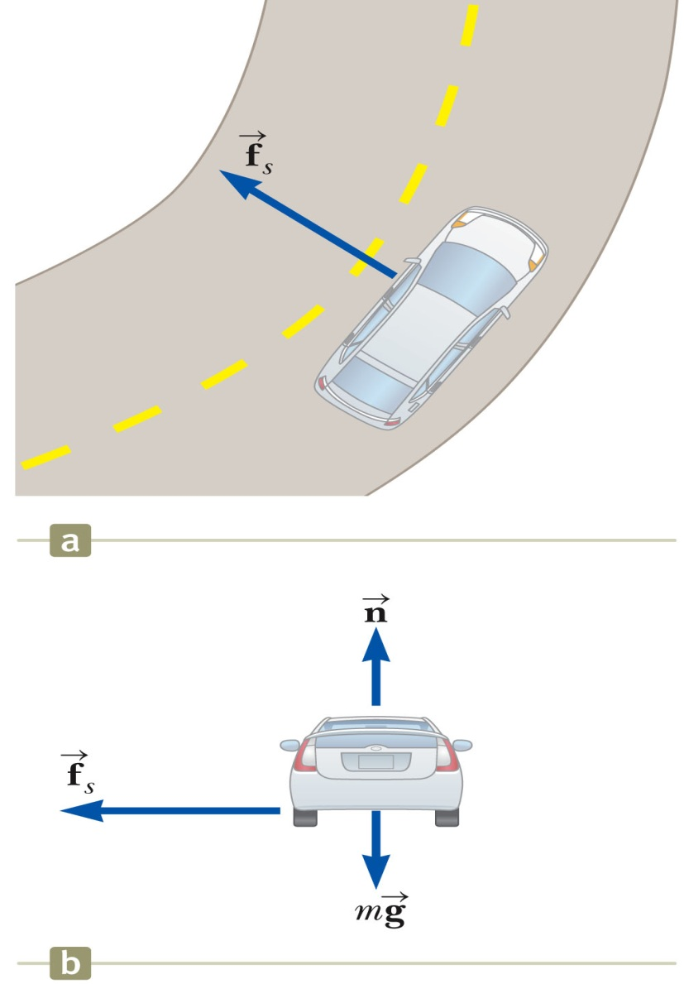
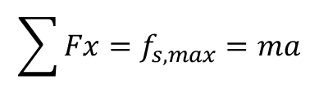
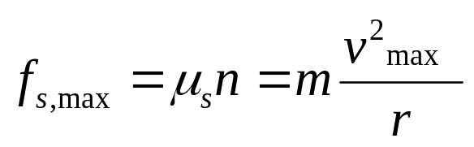
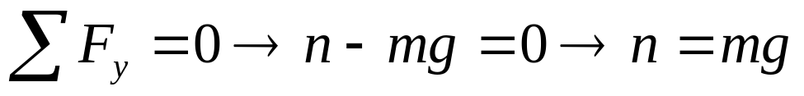
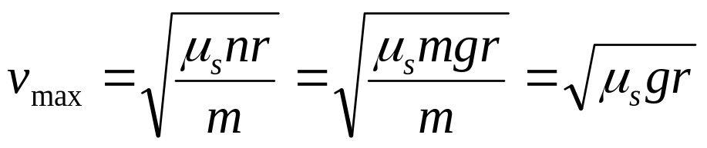
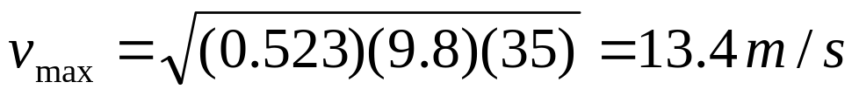
Horizontal (Flat) Curve
A 1 500-kg car moving on a flat, horizontal road negotiates a curve as shown in Figure 6.4a. If the radius of the curve is 35.0 m and the coefficient of static friction between the tires and dry pavement is 0.523, find the maximum speed the car can have and still make the turn successfully
Solution:
Section 6.1

Slide 12
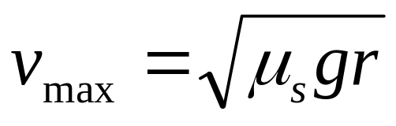
Conclusion: Horizontal (Flat) Curve
Note that the maximum speed does not depend on the mass of the car. That is why curved highways do not need multiple speed limit signs to cover the various masses of vehicles using the road

Slide 13
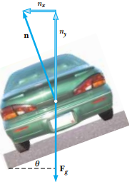
Problem:6.2 The Banked Roadway
A civil engineer wishes to design a curved exit ramp for a highway in such a way that a car will not have to rely on friction to round the curve without skidding. In other words, a car moving at the designated speed can negotiate the curve even when the road is covered with ice. Such a ramp is usually banked; this means the roadway is tilted toward the inside of the curve. Suppose the designated speed for the ramp is to be 13.4 m/s (30.0 mi/h) and the radius of the curve is 50.0 m.
At what angle should the curve be banked?

Slide 14
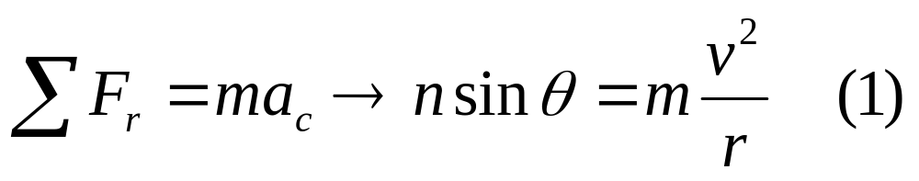
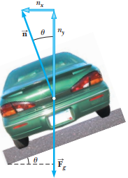
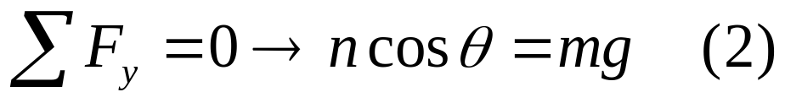
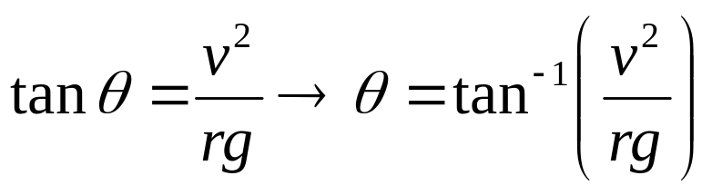

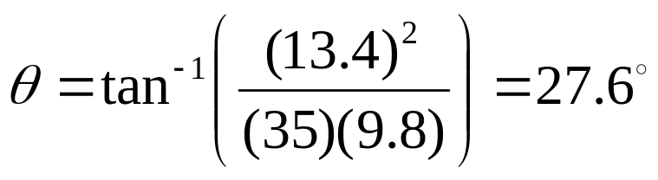
Solution:
Applying Newton’s second law
Divide Equation (1) by Equation (2):
What If? Imagine that this same roadway were built on Mars in the future to connect different colony centers. Could it be traveled at the same speed?

Slide 15
Banked Curve, 2
The banking angle is independent of the mass of the vehicle.
If the car rounds the curve at less than the design speed, friction is necessary to keep it from sliding down the bank.
If the car rounds the curve at more than the design speed, friction is necessary to keep it from sliding up the bank.
Section 6.1

Slide 16
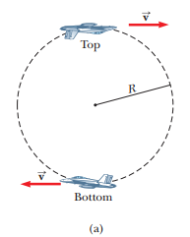
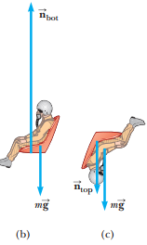
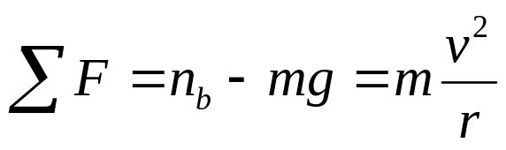
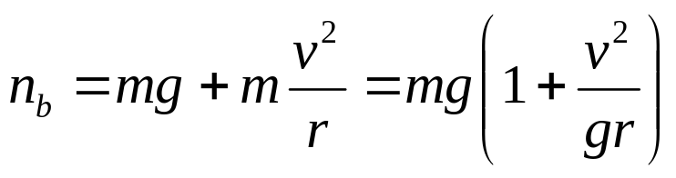
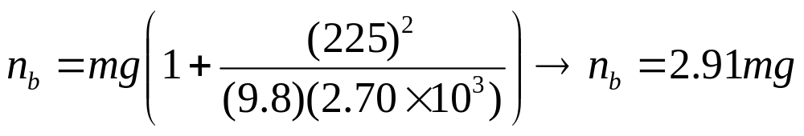
Problem 6.5: Let’s Go Loop-the-Loop!
A pilot of mass m in a jet aircraft executes a loop-the- loop, as shown in Figure. In this maneuver, the aircraft moves in a vertical circle of radius 2.70 km at a constant speed of 225 m/s.
(A) Determine the force exerted by the seat on the pilot at the bottom of the loop. Express your answer in terms of the weight of the pilot mg
Solution: At the bottom of loop

Slide 17
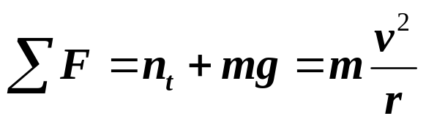
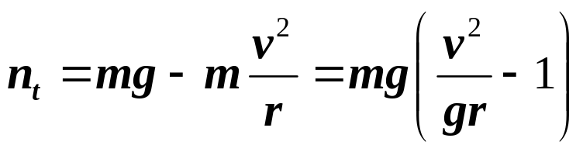
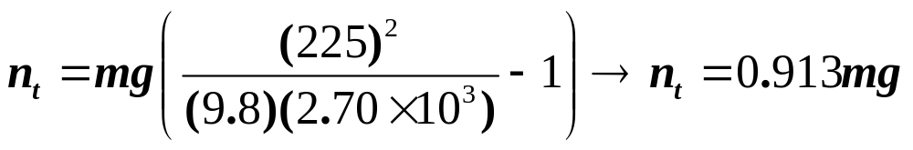
Problem 6.5: Let’s Go Loop-the-Loop!
(B) Determine the force exerted by the seat on the pilot at the top of the loop.
Solution: At the top of the loop

Slide 18
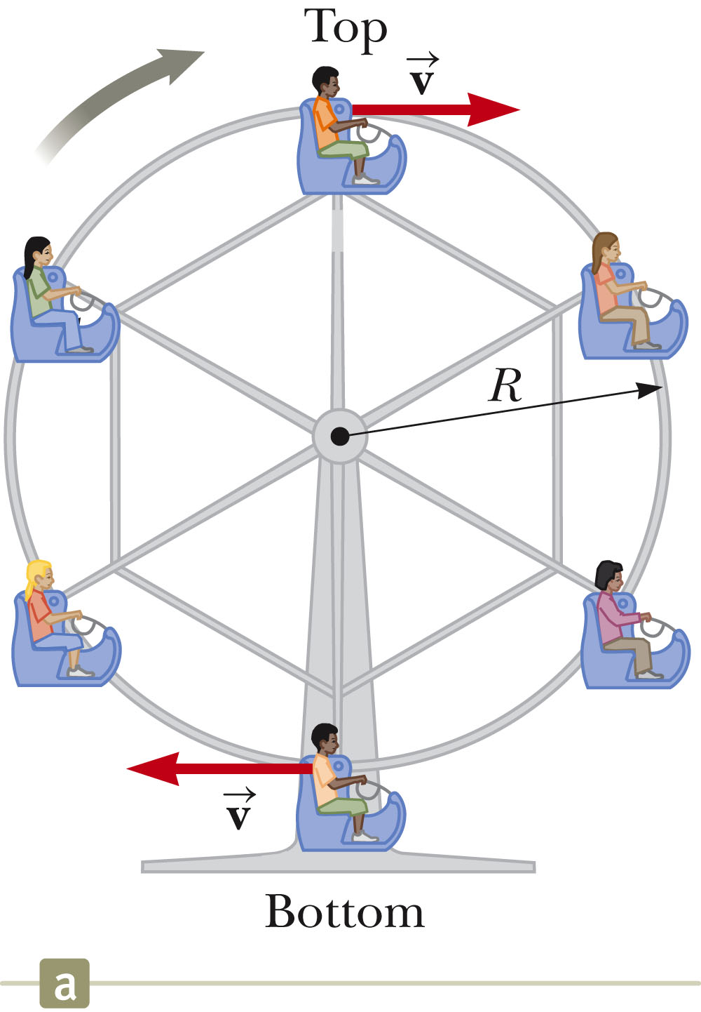
Ferris Wheel
The normal and gravitational forces act in opposite direction at the top and bottom of the path.
Section 6.1

Slide 19
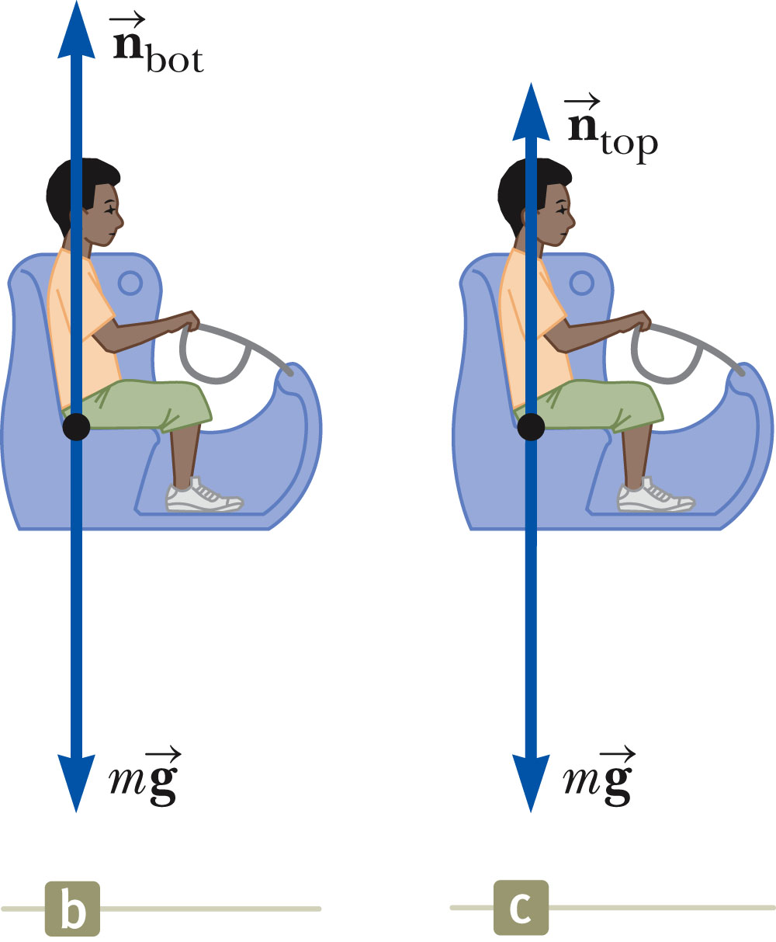
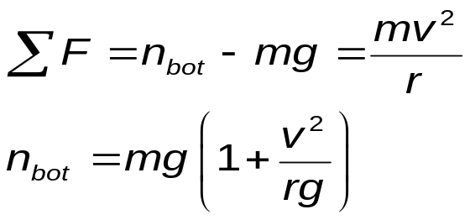
Ferris Wheel, cont.
At the bottom of the loop, the upward force (the normal) experienced by the object is greater than its weight.
Section 6.1

Slide 20
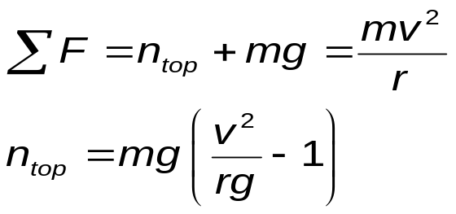
Ferris Wheel, final
At the top of the circle, the force exerted on the object is less than its weight.
Section 6.1

Slide 21
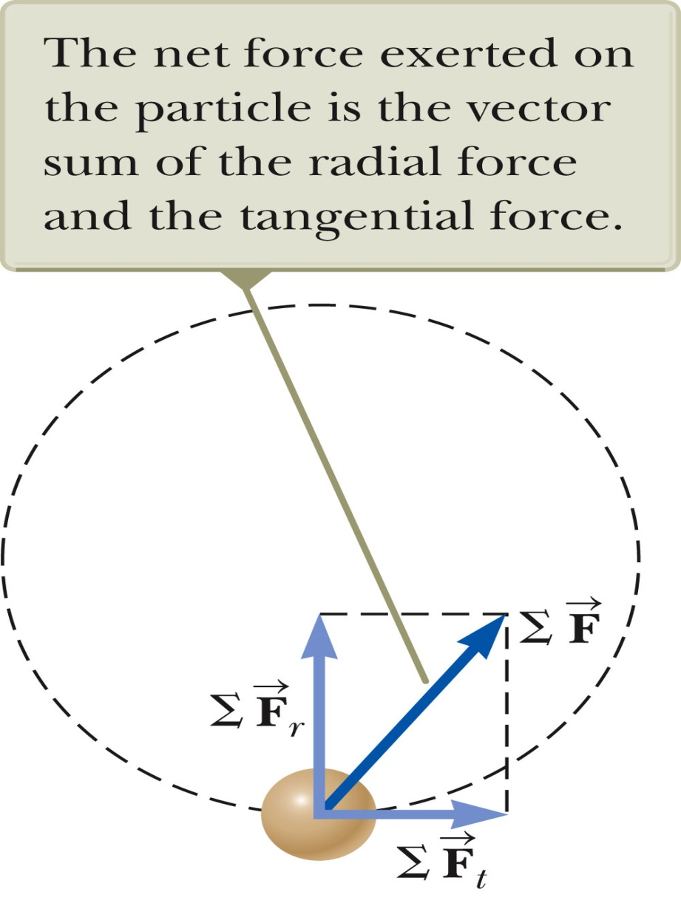


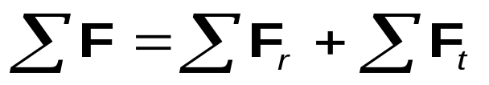
Non-Uniform Circular Motion
if a particle moves with varying speed in a circular path there is, in addition to the radial component of acceleration, a tangential component having magnitude dv/dt.
Because
The acceleration and force have tangential components.
produces the centripetal acceleration
produces the tangential acceleration
The total force is
Section 6.2

Slide 22
6.3:
Quick Quiz: Which of the following is impossible for a car moving in a circular path?
The car has tangential acceleration but no centripetal acceleration.
The car has centripetal acceleration but no tangential acceleration.
The car has both centripetal acceleration and tangential acceleration.

Slide 23
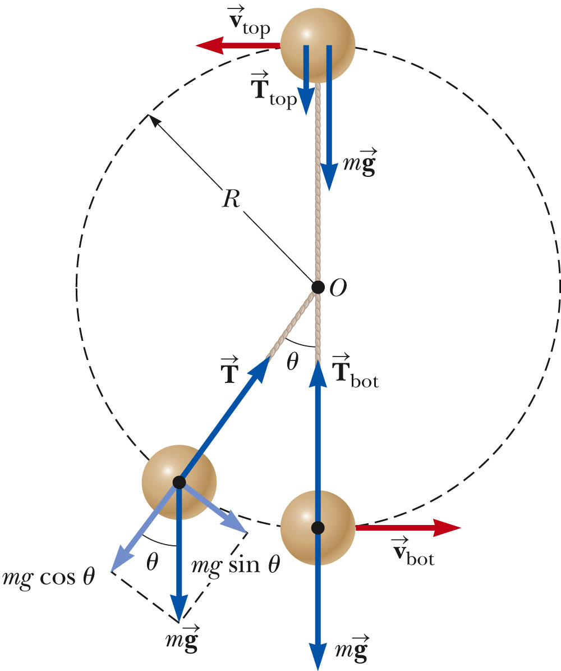
Problem 6.6: Vertical Circle with Non-Uniform Speed
A small sphere of mass m is attached to the end of a cord of length R and set into motion in a vertical circle about a fixed point O as illustrated in Figure.
Determine the tension in the cord at any instant when the speed of the sphere is v and the cord makes an angle θ with the vertical
Section 6.2

Slide 24

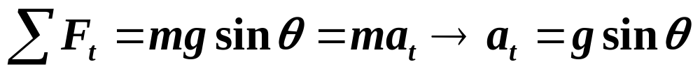
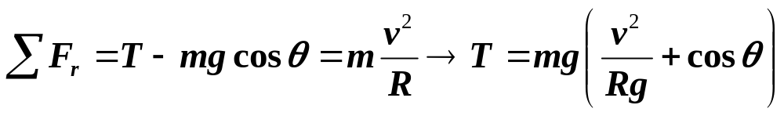
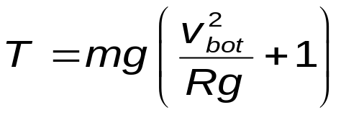
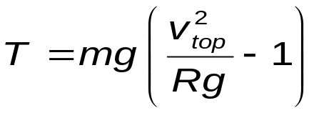

Top and Bottom of Circle
The tension at the bottom is a maximum.
The tension at the top is a minimum.
If T_{top} = 0, then
Section 6.2

Slide 25
Motion in Accelerated Frames
A fictitious force results from an accelerated frame of reference.
  The fictitious force is due to observations made in an accelerated frame.
  A fictitious force appears to act on an object in the same way as a real force, but you cannot identify a second object for the fictitious force.
    Remember that real forces are always interactions between two objects.
  Simple fictitious forces appear to act in the direction opposite that of the acceleration of the non-inertial frame.
Section 6.3

Slide 26

“Centrifugal” Force
From the frame of the passenger (b), a force appears to push her toward the door.
From the frame of the Earth, the car applies a leftward force on the passenger.
The outward force is often called a centrifugal force.
  It is a fictitious force due to the centripetal acceleration associated with the car’s change in direction.
In actuality, friction supplies the force to allow the passenger to move with the car.
  If the frictional force is not large enough, the passenger continues on her initial path according to Newton’s First Law.
Section 6.3

Slide 27

“Coriolis Force”
This is an apparent force caused by changing the radial position of an object in a rotating coordinate system.
The result of the rotation is the curved path of the thrown ball.
From the catcher’s point of view, a sideways force caused the ball to follow a curved path.
Section 6.3

Slide 28
Fictitious Forces, examples
Although fictitious forces are not real forces, they can have real effects.
Examples:
  Objects in the car do slide
  You feel pushed to the outside of a rotating platform
  The Coriolis force is responsible for the rotation of weather systems, including hurricanes, and ocean currents.
Section 6.3

Slide 29




Fictitious Forces in Linear Systems
The inertial observer models the sphere as a particle under a net force in the horizontal direction and a particle in equilibrium in the vertical direction.
The non-inertial observer models the sphere as a particle in equilibrium in both directions.
The inertial observer (a) at rest sees
The non-inertial observer (b) sees
These are equivalent if F_{fictiitous} = ma
Section 6.3

Slide 30

Motion with Resistive Forces
Motion can be through a medium.
  Either a liquid or a gas
The medium exerts a resistive force, , on an object moving through the medium.
The magnitude of depends on the medium.
The direction of is opposite the direction of motion of the object relative to the medium.
  This direction may or may not be in the direction opposite the object’s velocity according to the observer .
nearly always increases with increasing speed.
Section 6.4

Slide 31
Motion with Resistive Forces, cont.
The magnitude of can depend on the speed in complex ways.
We will discuss only two:
  is proportional to v
    Good approximation for slow motions or small objects
  is proportional to v²
    Good approximation for large objects
Section 6.4

Slide 32


Resistive Force Proportional To Speed
The resistive force can be expressed as
b depends on the property of the medium, and on the shape and dimensions of the object.
The negative sign indicates is in the opposite direction to .
Section 6.4

Slide 33


Resistive Force Proportional To Speed, Example
Assume a small sphere of mass m is released from rest in a liquid.
Forces acting on it are:
  Resistive force
  Gravitational force
Analyzing the motion results in
Section 6.4

Slide 34

Resistive Force Proportional To Speed, Example, cont.
Initially, v = 0 and dv/dt = g
As t increases, R increases and a decreases
The acceleration approaches 0 when R → mg
At this point, v approaches the terminal speed of the object.

Slide 35



Terminal Speed
To find the terminal speed, let a = 0
Solving the differential equation gives
τ is the time constant and
τ = m/b
Section 6.4

Slide 36
Resistive Force Proportional To v2
For objects moving at high speeds through air, the resistive force is approximately equal to the square of the speed.
R = ½ DrAv²
  D is a dimensionless empirical quantity called the drag coefficient.
  r is the density of air.
  A is the cross-sectional area of the object.
  v is the speed of the object.
Section 6.4

Slide 37


Resistive Force Proportional To v², example
Analysis of an object falling through air accounting for air resistance.
Section 6.4

Slide 38

Resistive Force Proportional To v², Terminal Speed
The terminal speed will occur when the acceleration goes to zero.
Solving the previous equation gives
Section 6.4

Slide 39

Some Terminal Speeds
Section 6.4

Slide 40

Example: Skysurfer
Step from plane
  Initial velocity is 0
  Gravity causes downward acceleration
  Downward speed increases, but so does upward resistive force
Eventually, downward force of gravity equals upward resistive force
  Traveling at terminal speed
Section 6.4

Slide 41
Skysurfer, cont.
Open parachute
  Some time after reaching terminal speed, the parachute is opened.
  Produces a drastic increase in the upward resistive force
  Net force, and acceleration, are now upward
    The downward velocity decreases.
  Eventually a new, smaller, terminal speed is reached.
Section 6.4

Slide 42
Example: Coffee Filters
A series of coffee filters is dropped and terminal speeds are measured.
The time constant is small
  Coffee filters reach terminal speed quickly
Parameters
  m_{each} = 1.64 g
  Stacked so that front-facing surface area does not increase
Model
  Treat the filter as a particle in equilibrium
Section 6.4

Slide 43

Coffee Filters, cont.
Data obtained from experiment:
At the terminal speed, the upward resistive force balances the downward gravitational force.
R = mg
Section 6.4

Slide 44

Coffee Filters, Graphical Analysis
Graph of resistive force and terminal speed does not produce a straight line.
The resistive force is not proportional to the object’s speed.
Section 6.4

Slide 45

Coffee Filters, Graphical Analysis 2
Graph of resistive force and terminal speed squared does produce a straight line.
The resistive force is proportional to the square of the object’s speed.
Section 6.4

Slide 46

Resistive Force on a Baseball – Example
The object is moving horizontally through the air.
The resistive force causes the ball to slow down.
Gravity causes its trajectory to curve downward.
The ball can be modeled as a particle under a net force.
  Consider one instant of time, so not concerned about the acceleration
Analyze to find D and R
Section 6.4

